Slide 1
SQL Server
User Defined Functions
In all slides, db=database

Slide 2
UDF
UDF stands for “User Defined Function” and, like a stored procedure, is something that you can create
Like a stored procedure (sproc), a UDF is
  an ordered set of T-SQL statements
  pre-optimized and compiled
  can be called to work as a single unit.

Slide 3
UDF vs. SPROC?
Then what’s the difference between a UDF and a SPROC?
  You can pass parameters in, but not out.
  Instead of output parameters, there is a more robust return value that is not limited to a integer-type return value.
User defined functions are extremely powerful in regards to what they can return. As we will see, a UDF can return not just a number, but an entire table.

Slide 4
UDFs (Cont’d)
There are two types of UDFs:
  Those that return a scalar value
    The term scalar refers to a “single” value
  Those that return a table

Slide 5

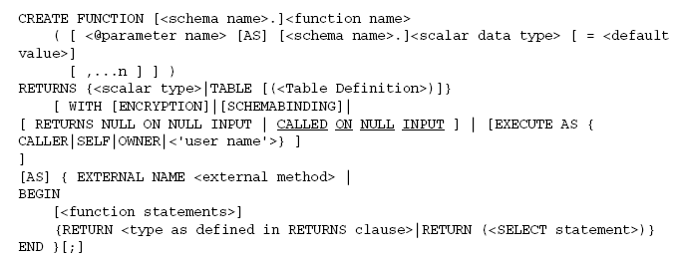
UDF Syntax

Slide 6
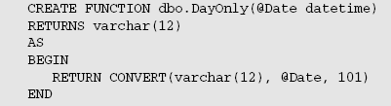

UDF Example
Created DayOnly UDF:
Using the UDF:

Slide 7
UDFs Returning a Scalar Value
A Scalar user-defined function returns one value. This value can have the data type of any valid SQL Server datatypes.
  The only datatypes not supported are BLOBs, cursors, and timestamps.
  Recall that sprocs were limited to integer types

Slide 8
UDF vs. Stored Procedure
Both are able to return an integer, so why might you use a UDF over a stored procedure?
  Unlike sprocs, the whole purpose of the return value is to serve as a meaningful piece of data. For sprocs, the return value indicates success/failure.
  You can perform functions in-line to your queries. This cannot be done with a sproc.

Slide 9
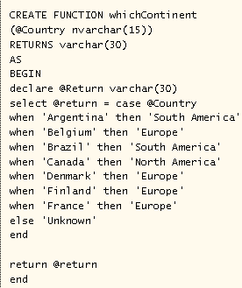
Scalar Defined UDF cont. T-SQL

Slide 10
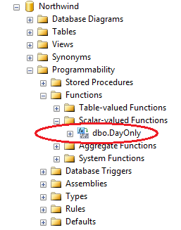
Functions in Management Studio

Slide 11
Function Schema
Note that the schema is required for functions
Remember that default schema is dbo
SELECT dbo.DateOnly(GETDATE())

Slide 12
Why Use a User-defined Function?
One reason to use UDFs is that you can embed queries in them and use them as an encapsulation method for subqueries.
  Logic is extracted away into a reusable function

Slide 13
UDF as an Encapsulation Method
Consider the following query – note that there are 2 subqueries
USE pubs
SELECT title, price, (SELECT AVG(price) FROM titles) As Average,
price - (SELECT AVG(price) FROM titles) As Difference
FROM titles
WHERE type = 'business';

Slide 14
UDF As an Encapsulation Method
Consider creating the following two Functions to calculate the Average Price and the Price Difference
CREATE FUNCTION dbo.AveragePrice()
RETURNS money
AS
BEGIN
RETURN (SELECT AVG(price) FROM titles);
END;
GO
CREATE FUNCTION dbo.PriceDifference(@Price money)
RETURNS money
AS
BEGIN
RETURN (@Price - dbo.AveragePrice());
END;
GO

Slide 15
UDF As an Encapsulation Method
We can then use our functions within our query
Note that embedding one function within another as was done in PriceDifference is allowed.
USE pubs
SELECT title, price,
dbo.AveragePrice() As Average,
dbo.PriceDifference(price) As Difference
FROM titles
WHERE type = 'business';

Slide 16
UDFs that Return a Table
UDFs are not limited to just returning scalar values – they can also return tables
Use “RETURNS TABLE”
  Note that a Table is treated like any other data type in the UDF’s definition

Slide 17
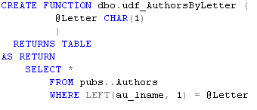
View vs. UDF to Return a Table
Why not just use a View instead of a UDF?
  Consider that a UDF can take parameters, whereas a view cannot
This function returns Authors whose name starts with a certain first letter

Slide 18
UDF Returning a Table Example
Consider a function that will returns authors whose sold a given number of books
USE pubs
GO
CREATE FUNCTION dbo.fnSalesCount(@SalesQty bigint)
RETURNS TABLE
AS
RETURN (SELECT au.au_id, au.au_lname + ', ' + au.au_fname as au_name, au.address, au.city + ', '+ au.state + ' ' + zip As Address2
FROM authors au
JOIN titleauthor ta ON au.au_id = ta.au_id
JOIN sales s ON ta.title_id = s.title_id
GROUP BY au.au_id, au.au_lname + ', ' + au.au_fname, au.address, au.city + ', '+ au.state + ' ' + zip
HAVING SUM(qty) > @SalesQty)
GO
Select * from dbo.fnSalesCount(25)

Slide 19
UDF vs. Stored Procedure
For the previous example, we could have created a stored procedure and executed with the EXEC command. Why use a user-defined function?
  You cannot join the results from a sproc to another table

Slide 20
UDF Table Result In a Join
Using the previous example, you could report the author and publisher for every author whose sold over 25 books by joining the results of your UDF to other tables.
SELECT DISTINCT p.pub_name, a.au_name
FROM dbo.fnSalesCount(25) AS a
JOIN titleauthor AS ta
ON a.au_id = ta.au_id
JOIN titles AS t
ON ta.title_id = t.title_id
JOIN publishers AS p
ON t.pub_id = p.pub_id

Slide 21
What Else Can UDFs do?
Functions can involve more than one statement or query, similar to a stored procedure
Note that UDFs that contain more than one line are called “multiline”. If returning a value in a multiline function, you need to associate a name to the return value
  Example – note that @Reports is the name of the return value:
  CREATE FUNCTION dbo.fnGetReports
  (@EmployeeID as int)
  RETURNS @Reports TABLE
(
Employee int NOT NULL,
ReportsToID int NULL
)
After the keyword TABLE, a definition of the table is required.

Slide 22
UDFs and Recursion
UDFs support recursion
  A block of code is said to recurse any time it calls itself.
  Recursion is an important concept when processing all levels of a hierarchy

Slide 23
Recursion Example
Consider that we want a report that includes a list of all employees that report to a given manager. This list should include employees who report to those who report to this person, and so on building what most organizations call an “organization chart”.
If you pass in Andrew Fuller’s employeeID, you would get back the 5 people that report to him directly as well as those who report to those employees, etc.

Slide 24
Recursion Example (cont’d)
Database = Northwind
Recall that the Employees table has a column called ReportsTo which is a foreign key which points back to the Employees table.
Employees
PK - EmployeeID
ReportsTo

Slide 25
Recursion Example (cont’d)
Steps needed:
  Figure out all the people who report to the manager we want
  For each person in Step 1, we need to know who reports to them
  Repeat Step 2 until there are no more subordinates
We are going to need several statements in our function to make this work (multiline)
As a side note, SQL server does have the limitation that you can only go 32 levels deep into recursion.

Slide 26
Recursion Example (cont’d)
CREATE FUNCTION dbo.fnGetReports
(@EmployeeID AS int)
RETURNS @Reports TABLE
(
EmployeeID int NOT NULL,
ReportsToID int NULL
)
AS
BEGIN
DECLARE @Employee AS int
INSERT INTO @Reports
SELECT EmployeeID, ReportsTo
FROM Employees
WHERE EmployeeID = @EmployeeID
SELECT @Employee = MIN(EmployeeID)
FROM Employees
WHERE ReportsTo = @EmployeeID
Continued from previous block….
WHILE @Employee IS NOT NULL
BEGIN
INSERT INTO @Reports
SELECT *
FROM fnGetreports(@Employee)
SELECT @Employee = MIN(EmployeeID)
FROM Employees
WHERE EmployeeID > @Employee
AND ReportsTo = @EmployeeID
END
RETURN
END
GO

Slide 27
Recursion Example (cont’d)
Results from our function can be linked to other tables using JOINs to provide name information
SELECT Emp.EmployeeID, Emp.FirstName, Emp.LastName, Mgr.LastName as ReportsTo
FROM Employees AS Emp
JOIN dbo.fnGetReports(2) AS gr
ON gr.EmployeeID = Emp.EmployeeID
JOIN Employees AS Mgr
ON Mgr.EmployeeID = gr.ReportsToID

Slide 28
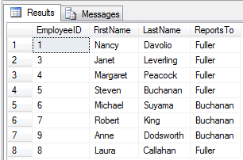
Recursion Example (cont’d)
The final results show us exactly what we were after – all employees who report directly to Andrew Fuller as well as any that report to those individuals, etc. down the line. Our objective was to build an organizational hierarchy for Andrew Fuller as shown below.

Slide 29
What you can’t do with UDFs
INSERT, UPDATE, DELETE rows
  Except to TABLE variables
Execute Stored Procedures
DBCC
  Database Console Commands. These statements check the physical and logical consistency of a database.
RAISERROR
PRINT
BEGIN CATCH…. END TRY

